Slide 1



AI Master Class series – Day 24
Fake News Detection using ML

Slide 2
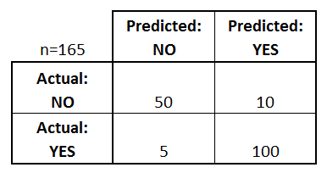
Confusion Matrix
A confusion matrix is a table that is often used to describe the performance of a classification model on a set of test data for which the true values are known.
Ex:
COVID – 19 - Binary prediction (Yes / No)
Total no. of Patient : 165
Real Data:
Covid Yes – 105 Patient
No Covid – 60 Patient
Our ML Predicted Data:
Covid Yes – 110 Patient
No Covid – 55 Patient

Slide 3
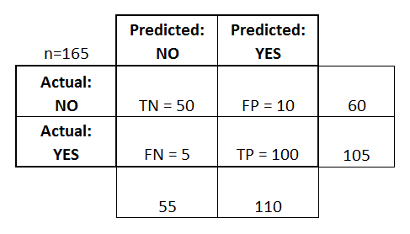
Confusion Matrix
True positives (TP): These are cases in which we predicted yes (they have the covid), and they have the covid.
True negatives (TN): We predicted no, and they don't have the covid.
False positives (FP): We predicted yes, but they don't actually have the covid. (Also known as a "Type I error.")
False negatives (FN): We predicted no, but they actually have the covid. (Also known as a "Type II error.")

Slide 4
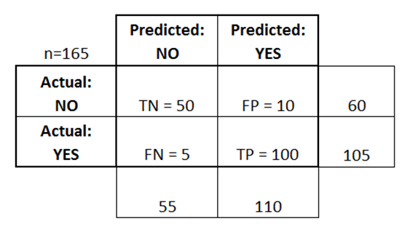
Accuracy & Loss Calculation from Confusion Matrix
Accuracy: Overall correct.
(TP+TN)/total = (100+50)/165 = 0.91
Misclassification Rate: Overall wrong | Error Rate
(FP+FN)/total = (10+5)/165 = 0.09

Slide 5
Other rates from Confusion Matrix
True Positive Rate: Sensitivity or Recall
TP/actual yes = 100/105 = 0.95
False Positive Rate:
FP/actual no = 10/60 = 0.17
True Negative Rate: Specificity
TN/actual no = 50/60 = 0.83
Precision:
TP/predicted yes = 100/110 = 0.91
Prevalence :
actual yes/total = 105/165 = 0.64

Slide 6
Feature extraction in Text - Methods
build_analyzer() - Return a callable that handles preprocessing, tokenization and n-grams generation.
build_preprocessor() - Return a function to preprocess the text before tokenization.
build_tokenizer() - Return a function that splits a string into a sequence of tokens.
decode(doc) - Decode the input into a string of unicode symbols.
fit(raw_documents[, y]) - Learn a vocabulary dictionary of all tokens in the raw documents.
fit_transform(raw_documents[, y]) - Learn the vocabulary dictionary and return document-term matrix.
get_feature_names() - Array mapping from feature integer indices to feature name.
get_params([deep]) - Get parameters for this estimator.
get_stop_words() - Build or fetch the effective stop words list.
inverse_transform(X) - Return terms per document with nonzero entries in X.
set_params(**params) - Set the parameters of this estimator.
transform(raw_documents) - Transform documents to document-term matrix.

Slide 7
CountVectorizer – Types of feature extraction in Text
Convert a collection of text documents to a matrix of token counts
HashingVectorizer – Types of feature extraction in Text
Convert a collection of text documents to a matrix of token occurrences

Slide 8
TfidfVectorizer – Types of Feature extraction in Text
Term-frequency times inverse document-frequency.
Convert a collection of raw documents to a matrix of TF-IDF features.
Equivalent to CountVectorizer followed by TfidfTransformer.
TfidfVectorizer. get_feature_names
DATA= [
'This is the first document.',
'This document is the second document.',
'And this is the third one.',
'Is this the first document?']
X = vectorizer.fit_transform(DATA)
TfidfVectorizer. get_feature_names
['and', 'document', 'first', 'is', 'one', 'second', 'the', 'third', 'this']

Slide 9
PassiveAggressiveClassifier - ML Algorithm
Passive-Aggressive algorithms are generally used for large-scale learning. It is one of the few ‘online-learning algorithms‘.
Data are Dynamic
max_iter : The maximum number of iterations the model makes over the training data.
Passive: If the prediction is correct, keep the model and do not make any changes. i.e., the data in the example is not enough to cause any changes in the model.
Aggressive: If the prediction is incorrect, make changes to the model. i.e., some change to the model, may correct it.

Slide 10
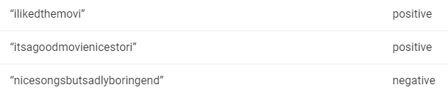
naive_bayes - MultinomialNB - ML Algorithm
Naive Bayes are mostly used in natural language processing (NLP) problems. Naive Bayes predict the tag of a text.
They calculate the probability of each tag for a given text and then output the tag with the highest one.
Bayes theorem calculates probability P(c|x) where c is the class of the possible outcomes and x is the given instance which has to be classified
Removing Stopwords: These are common words that don’t really add anything to the classification, such as an able, either, else, ever and so on.
Stemming: Stemming to take out the root of the word.

Slide 11
Workflow of Fake News Detection.
Loading Library & dataset
Visualizing & processing Dataset
Dataset Splitting as Train & Val
Applying Text feature extractor
Applying Ml Algorithm
Training ML Model
Test Trained Model from Val dataset
Confusion Matrix

Slide 12
ML Syntax
DataFrame
A Data frame is a two-dimensional data structure, i.e., data is aligned in a tabular fashion in rows and columns.
df = pd.DataFrame({'month': [1, 4, 7, 10],
'year': [2012, 2014, 2013, 2014],
'sale': [55, 40, 84, 31]})
month year sale
0 1 2012 55
1 4 2014 40
2 7 2013 84
3 10 2014 31

Slide 13
ML Syntax
set_index
Set the DataFrame index using existing columns.
df.set_index('month')
year sale
month
1 2012 55
4 2014 40
7 2013 84
10 2014 31

Slide 14
ML Syntax
drop('label', axis=1)
Drop specified labels from rows or columns.
df.drop('month‘,axis=1) or df.drop(columns='month’)
year sale
2012 55
2014 40
2013 84
2014 31

Slide 15
ML Syntax
Difference - Set
A = {10, 20, 30, 40, 80}
B = {100, 30, 80, 40, 60}
print (A.difference(B))
print (B.difference(A))
{10, 20}
{100, 60}

Slide 16

! PRACTICAL SESSION !

Slide 17
Fake News Detection using ML Algorithm

Slide 18


AI News – Day 24. OCT - 2020
Apple Inc. acquired a startup specializing in advanced artificial intelligence and computer vision technology that may help the iPhone maker improve its own AI across a number of apps and services.
Vilynx developed technology that uses AI to analyze a video’s visual, audio and text content to understand what the video shows. It used that technology to create tags for the video, making it searchable.

Slide 19
Thanks!
Tomorrow session
AI Snake Game

Slide 20
Day-24 Agenda.
01.
02.
03.
Confusion Matrix
Text Feature Extraction
ML Algorithm
04.
05.
Deploying ML application
Q & A
Confusion Matrix & Accuracy Calculation
Various Text Feature Extraction techniques & its Syntax
New ML algorithms & Basic Syntax
Fake News detection using Ml algorithm

